Slide 1

Random PowerPoint Karaoke: A Fun and Spontaneous Presentation
Engaging topics for creativity and fun exploration
Notes:
AI-generated content may be incorrect. --- Welcome to our Random PowerPoint Karaoke! This presentation is a delightful mix of intriguing topics that will spark your imagination and creativity. Each slide will provide a snapshot of a unique subject, and we will explore them in a fun and spontaneous manner. Image source: Microsoft 365 content library

Slide 2
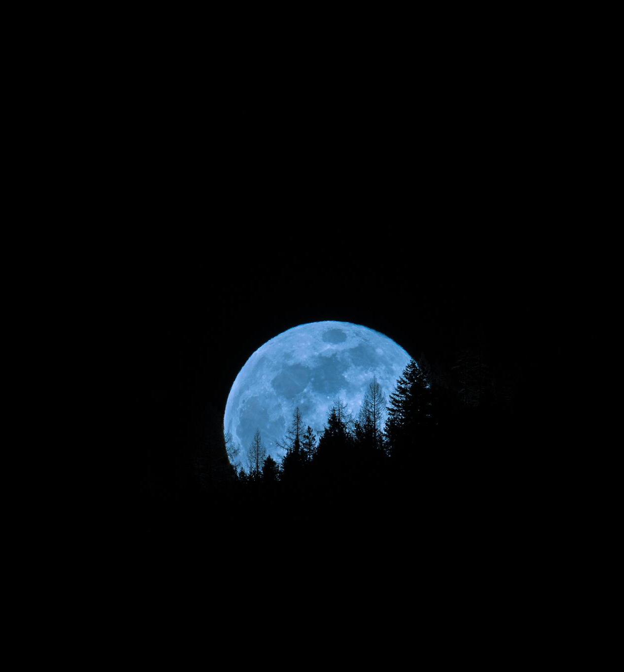
Session Outline
Slide 1: A Majestic Mountain Range
Slide 2: A Vintage Car Show
Slide 3: A Cat in a Funny Costume
Slide 4: A Busy Cityscape at Night
Slide 5: A Delicious Gourmet Meal
Slide 6: A Space Shuttle Launch
Slide 7: A Vintage Record Player
Slide 8: A Scenic Beach Sunset
Slide 9: A Colorful Hot Air Balloon Festival
Slide 10: A Group of Friends Hiking
Notes:
--- In this session, we will dive into ten diverse topics ranging from the beauty of nature to the excitement of space exploration. Each topic is designed to ignite your creativity and provide a platform for spontaneous storytelling. Image source: Microsoft 365 content library

Slide 3
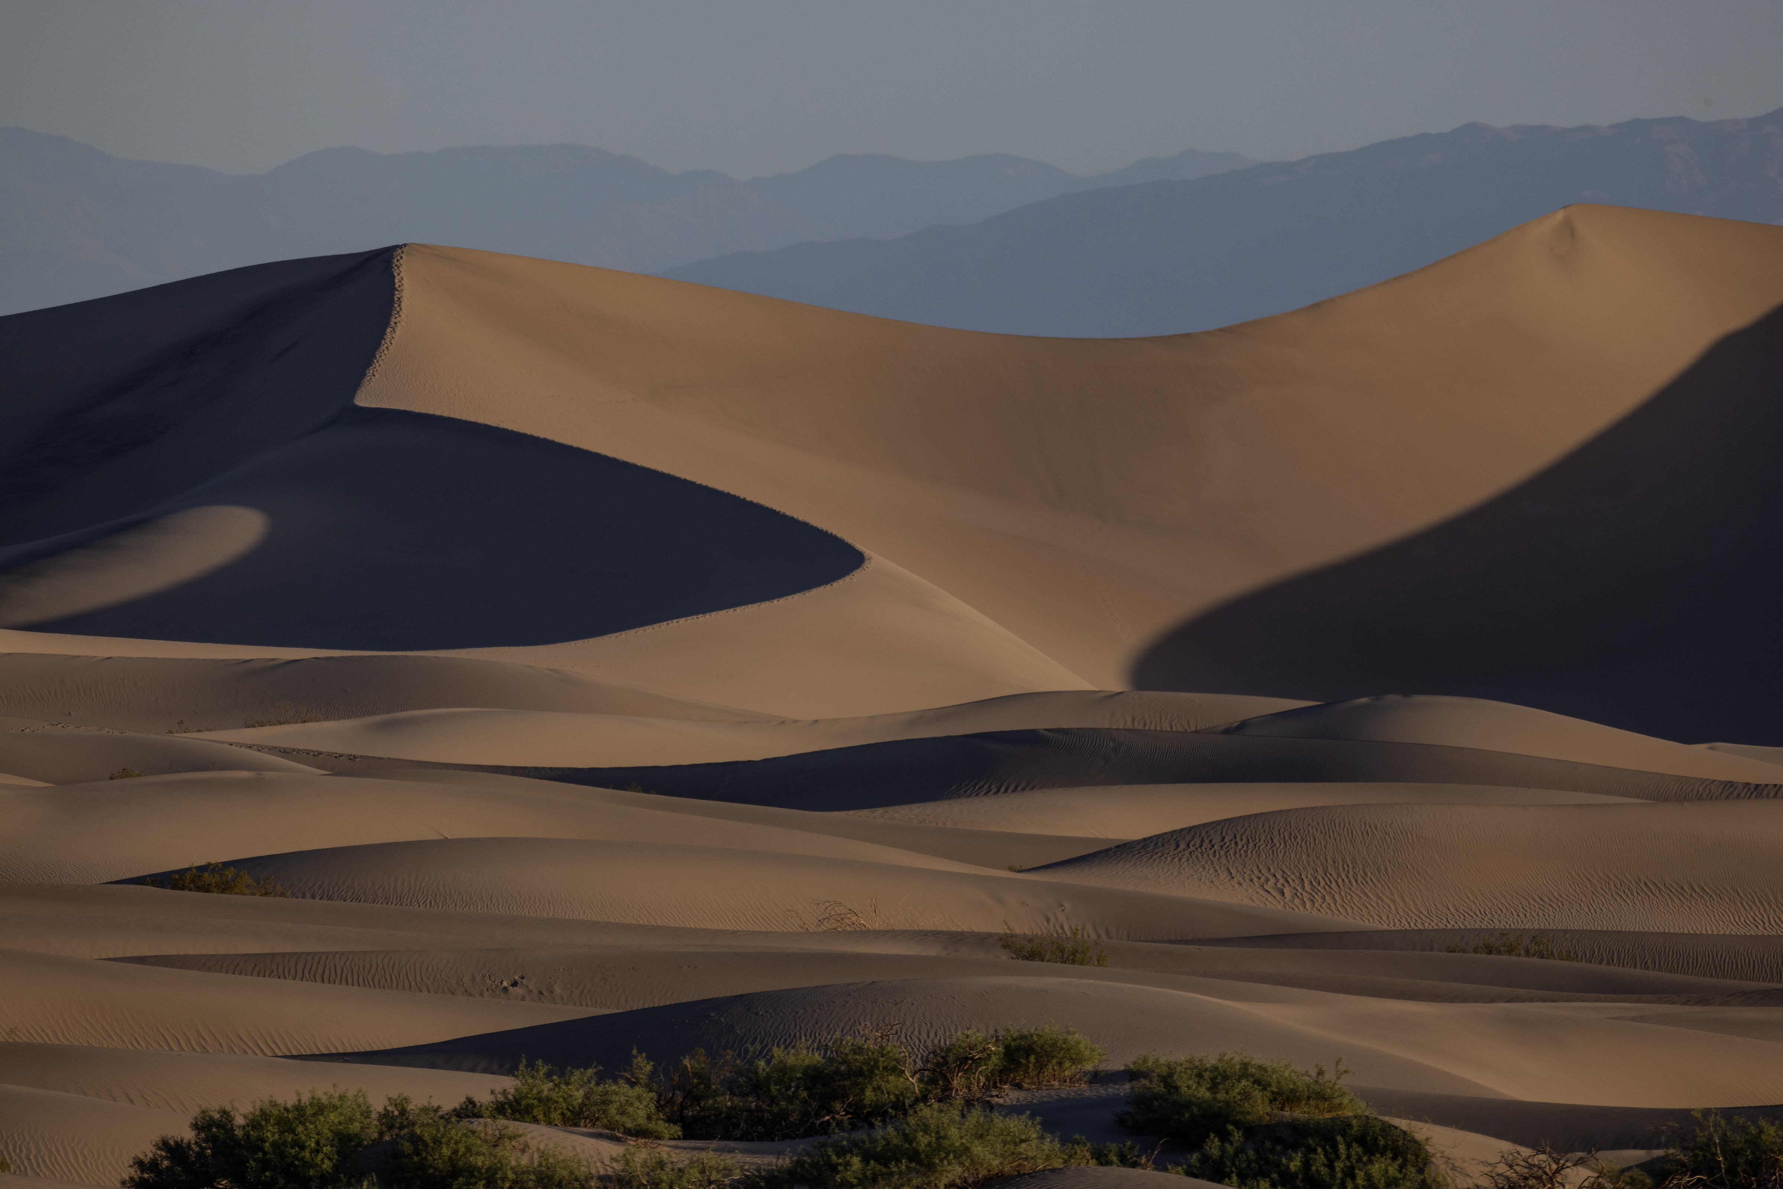
Notes:
--- Nature's grandeur is best experienced in the mountains, where stunning landscapes meet fresh air. The beauty of majestic mountain ranges provides a peaceful escape for all nature lovers. Image source: Microsoft brand library

Slide 4
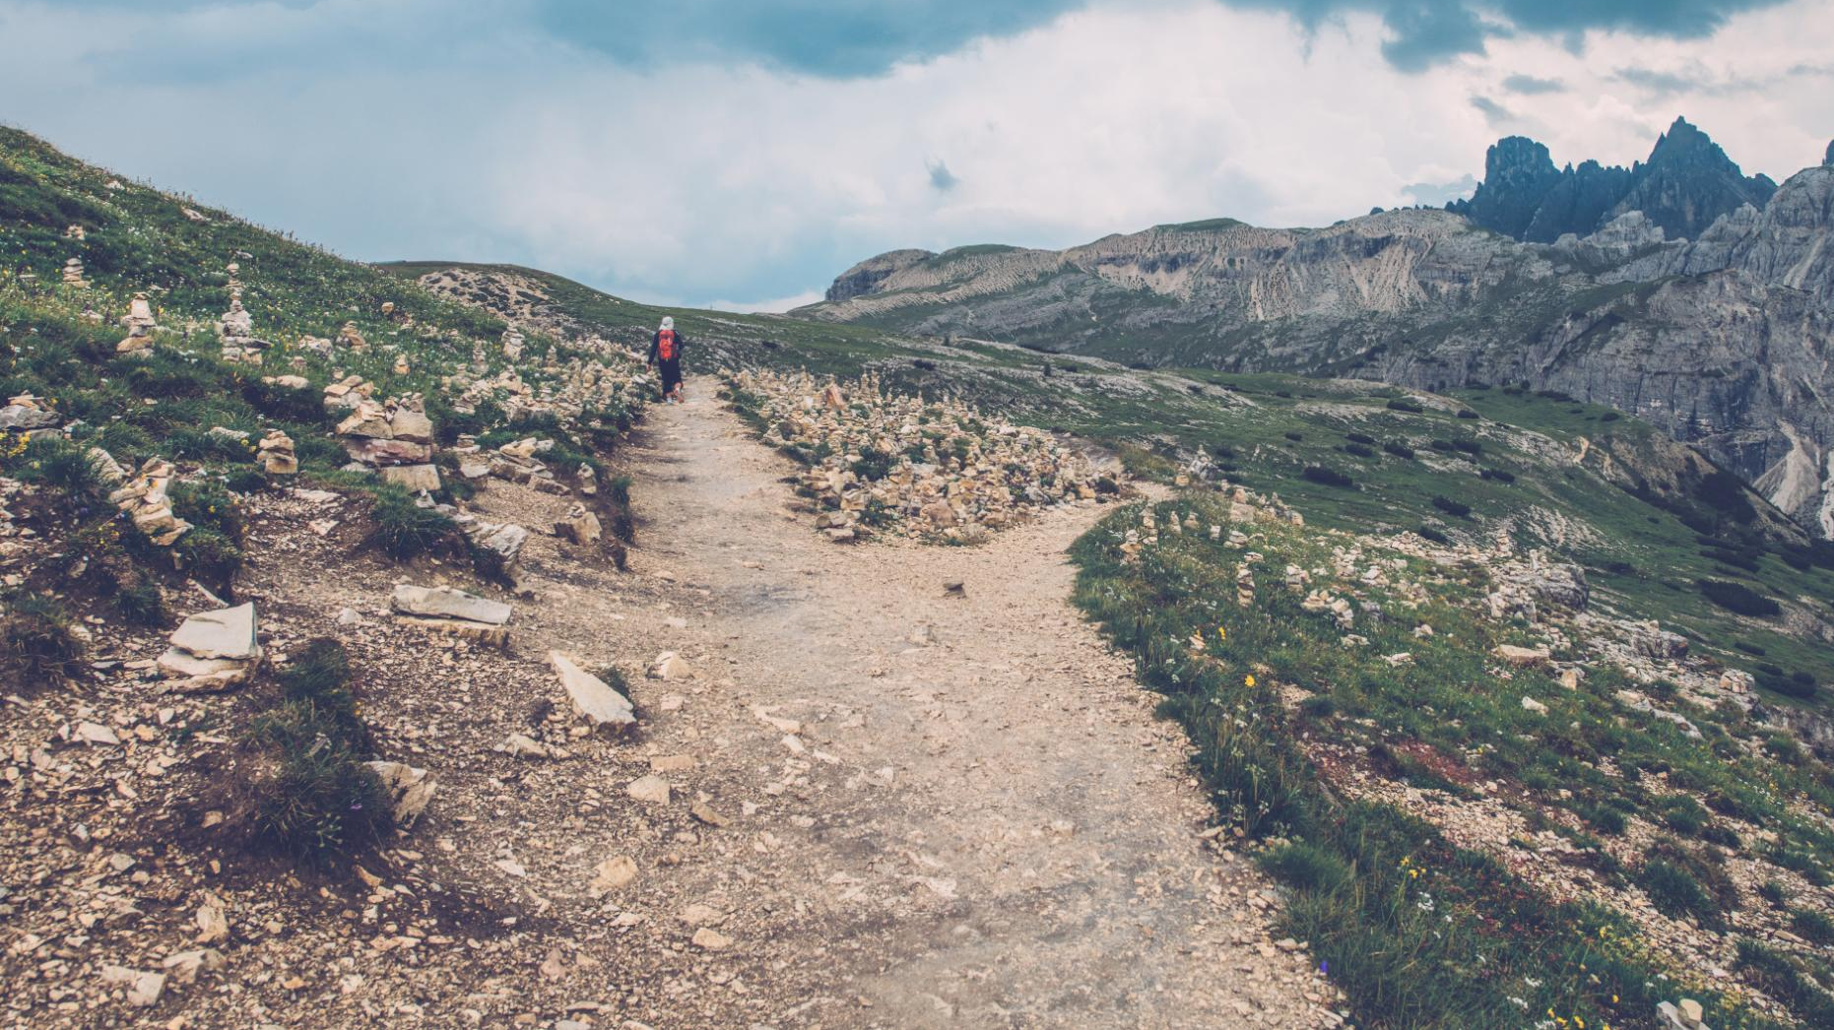
Notes:
--- Hiking trails in mountainous regions offer adventurous experiences for all skill levels. From beginner paths to challenging climbs, there's always a new adventure waiting in the great outdoors. Image source: Microsoft 365 content library

Slide 5

Notes:
--- Car shows gather passionate enthusiasts who share their love for vintage automobiles. Collectors pride themselves on preserving these classic cars for future generations to appreciate. Image source: Microsoft 365 content library

Slide 6

Notes:
--- Pet fashion has exploded in popularity, with unique styles and trends emerging. From seasonal costumes to themed outfits, pets are donning apparel that showcases their personality. Image source: Microsoft 365 content library

Slide 7
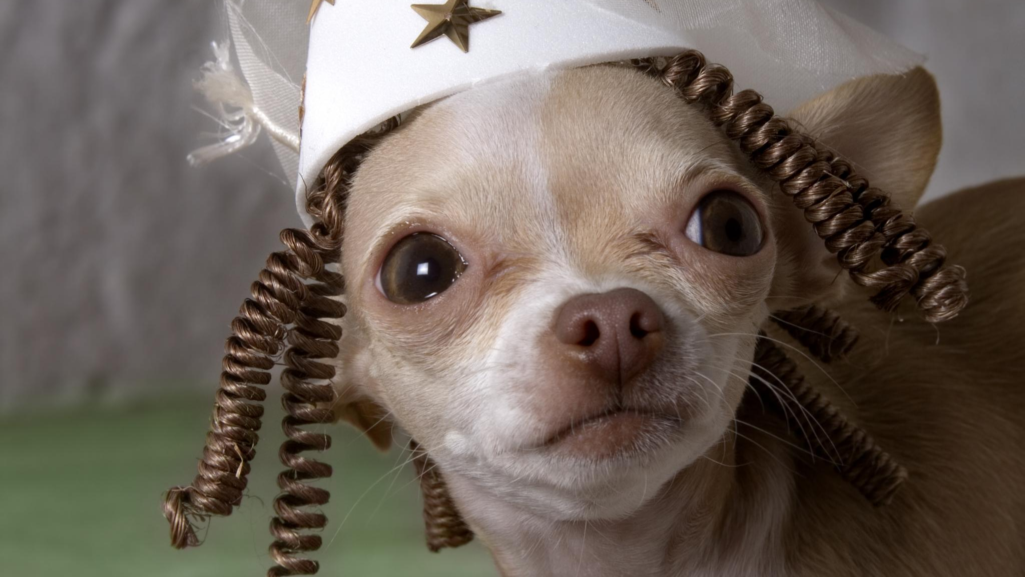
Notes:
--- Dressing up pets is not just about fashion; it’s about creating memorable moments. Watching a pet in a funny costume can brighten anyone's day and provide endless entertainment. Image source: Microsoft 365 content library

Slide 8

Notes:
--- Living in a metropolitan city provides access to diverse cultures, entertainment, and opportunities. However, it also brings the challenges of fast-paced living and crowded spaces. Image source: Microsoft brand library

Slide 9
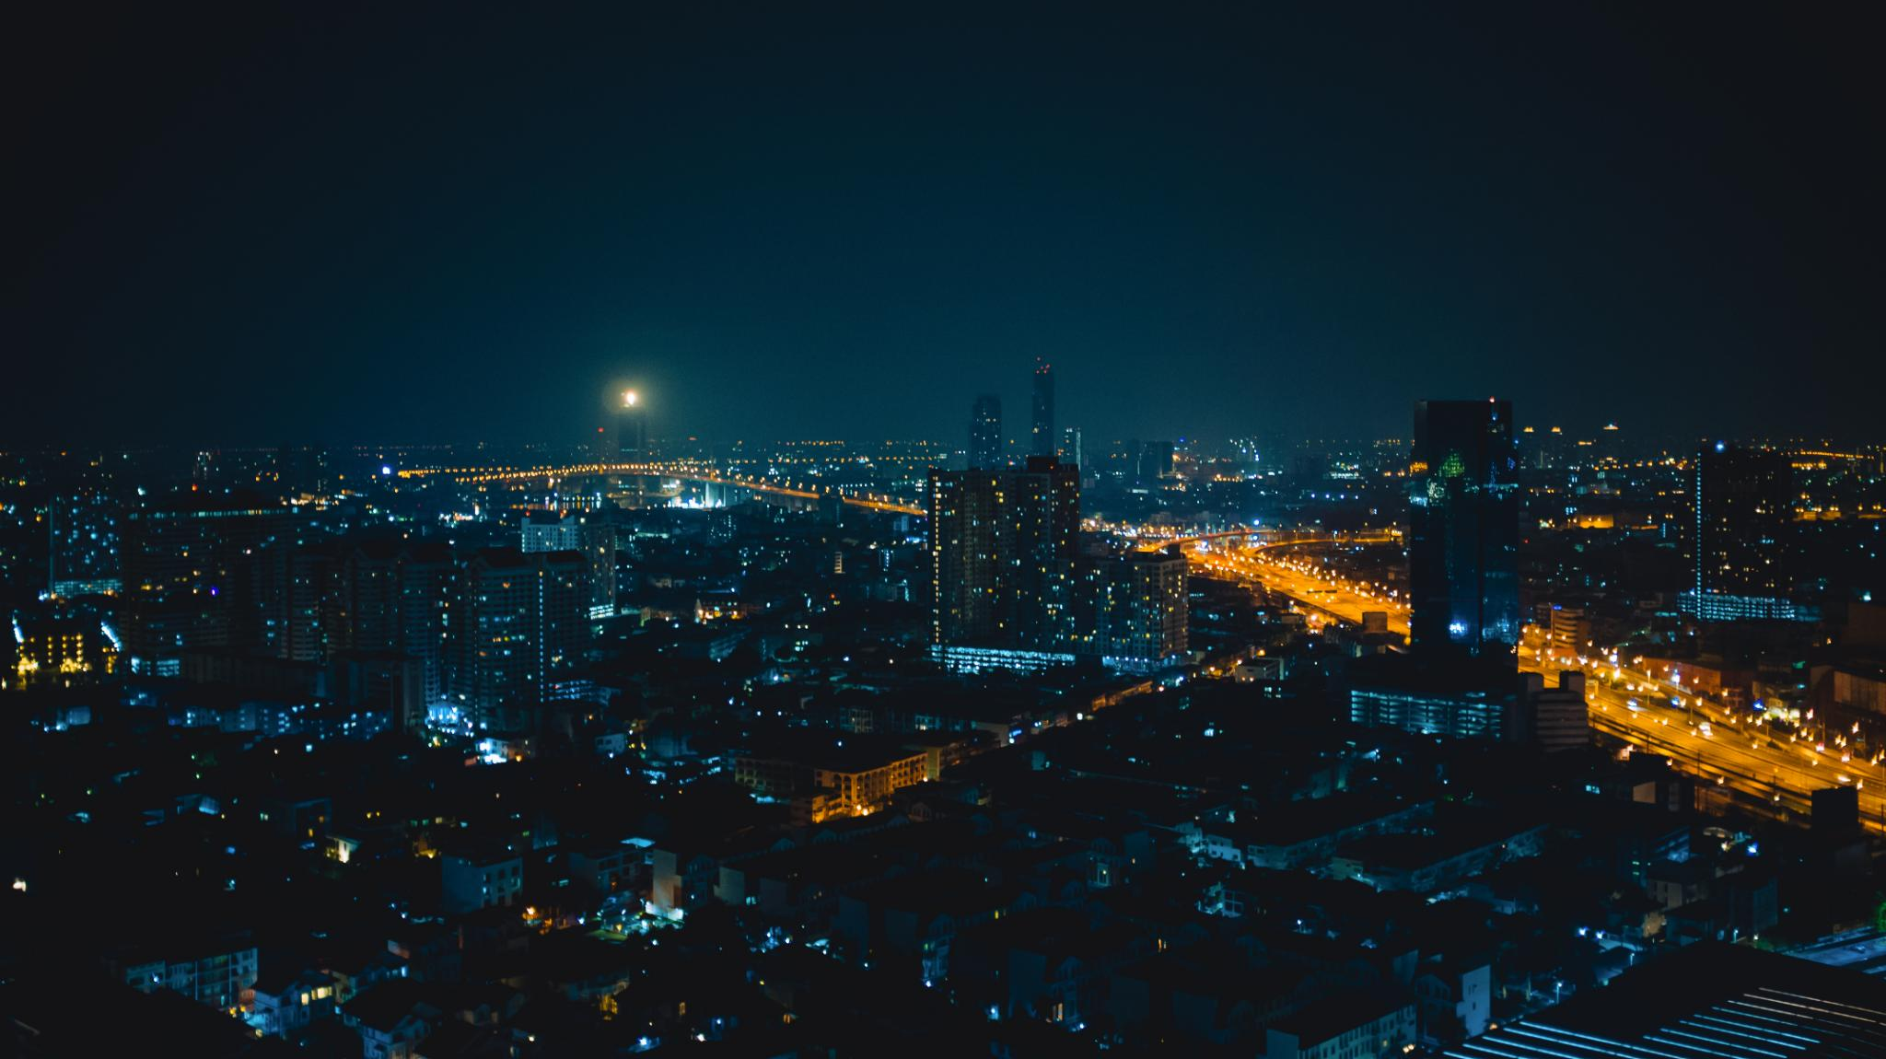
Notes:
--- Urban nightlife is bustling with activity, from restaurants to clubs and late-night events. The city's energy transforms after dark, offering countless experiences for night owls. Image source: Microsoft 365 content library

Slide 10
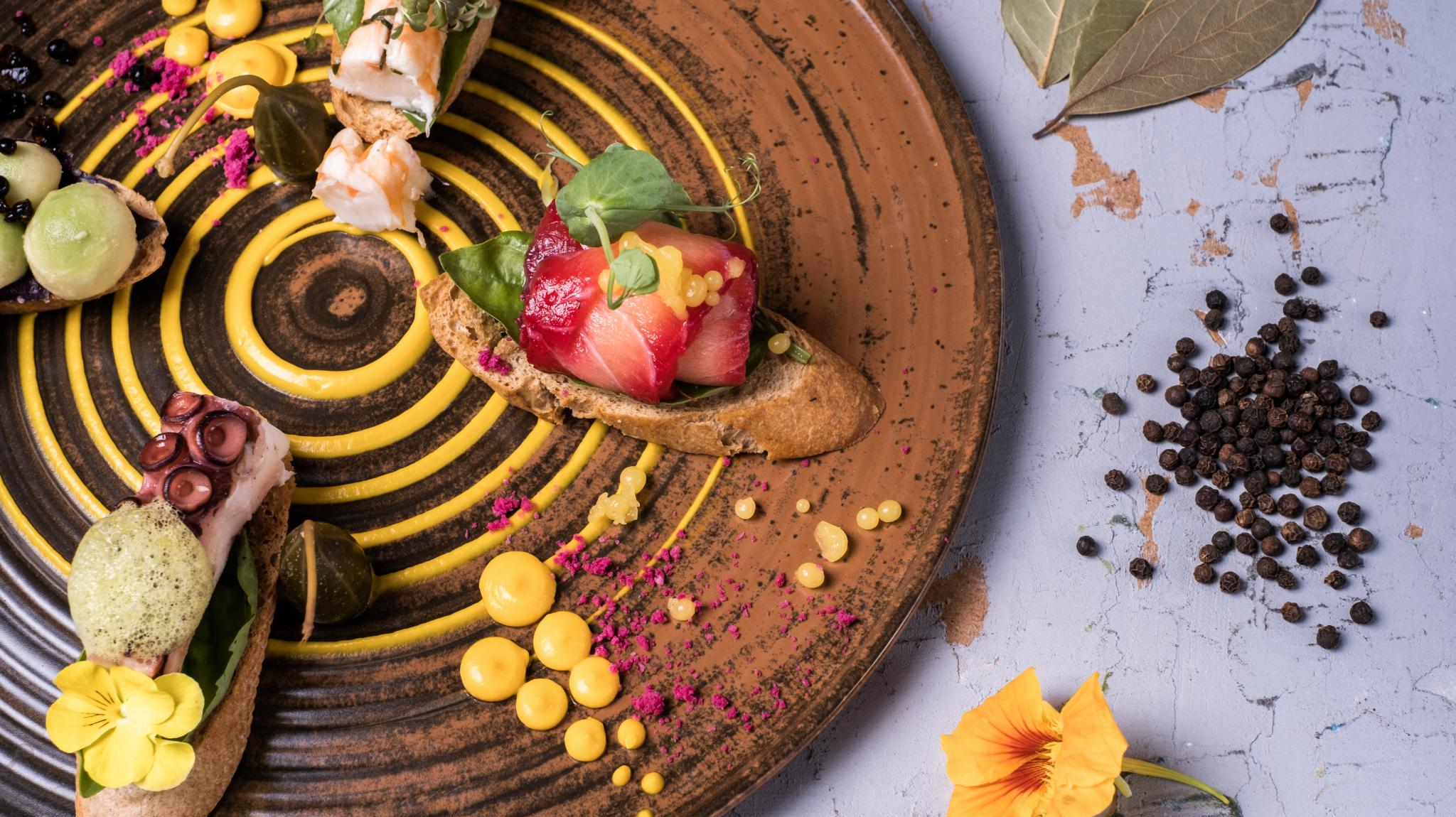
Notes:
--- The culinary arts involve creativity and skill, where chefs create gourmet meals that tantalize the taste buds. Understanding flavors and techniques is essential to gourmet cooking. Image source: Microsoft 365 content library

Slide 11
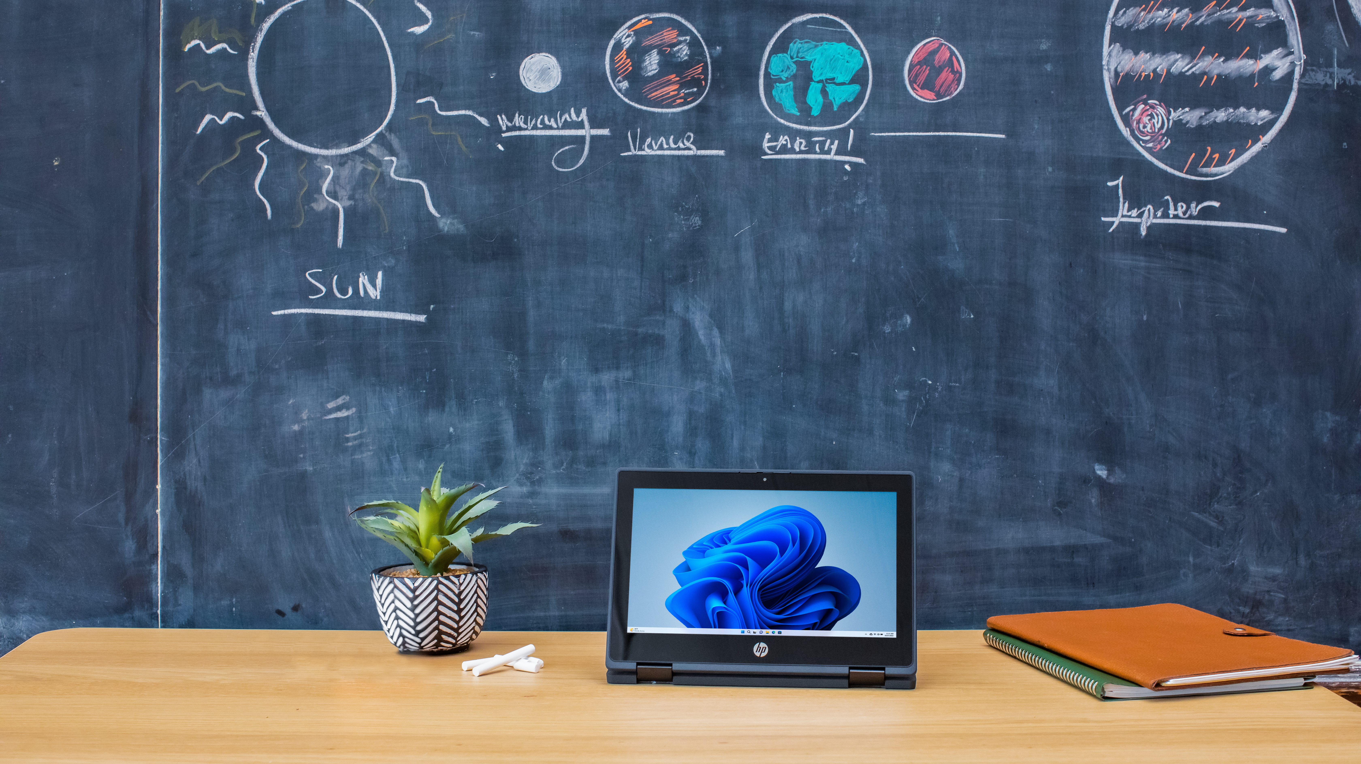
Notes:
--- Advancements in technology have revolutionized space exploration, allowing us to reach new heights and understand our universe better. Each launch brings us closer to unraveling its mysteries. Image source: Microsoft brand library

Slide 12

Notes:
--- Listening to music on a vintage record player offers a warm, rich sound that many enthusiasts cherish. The tactile experience of handling records adds to the nostalgia. Image source: Microsoft 365 content library

Slide 13

Notes:
--- Beach vacations are synonymous with relaxation. The soothing sound of the ocean and the warm sun create the perfect atmosphere for rest and rejuvenation. Image source: Microsoft 365 content library

Slide 14
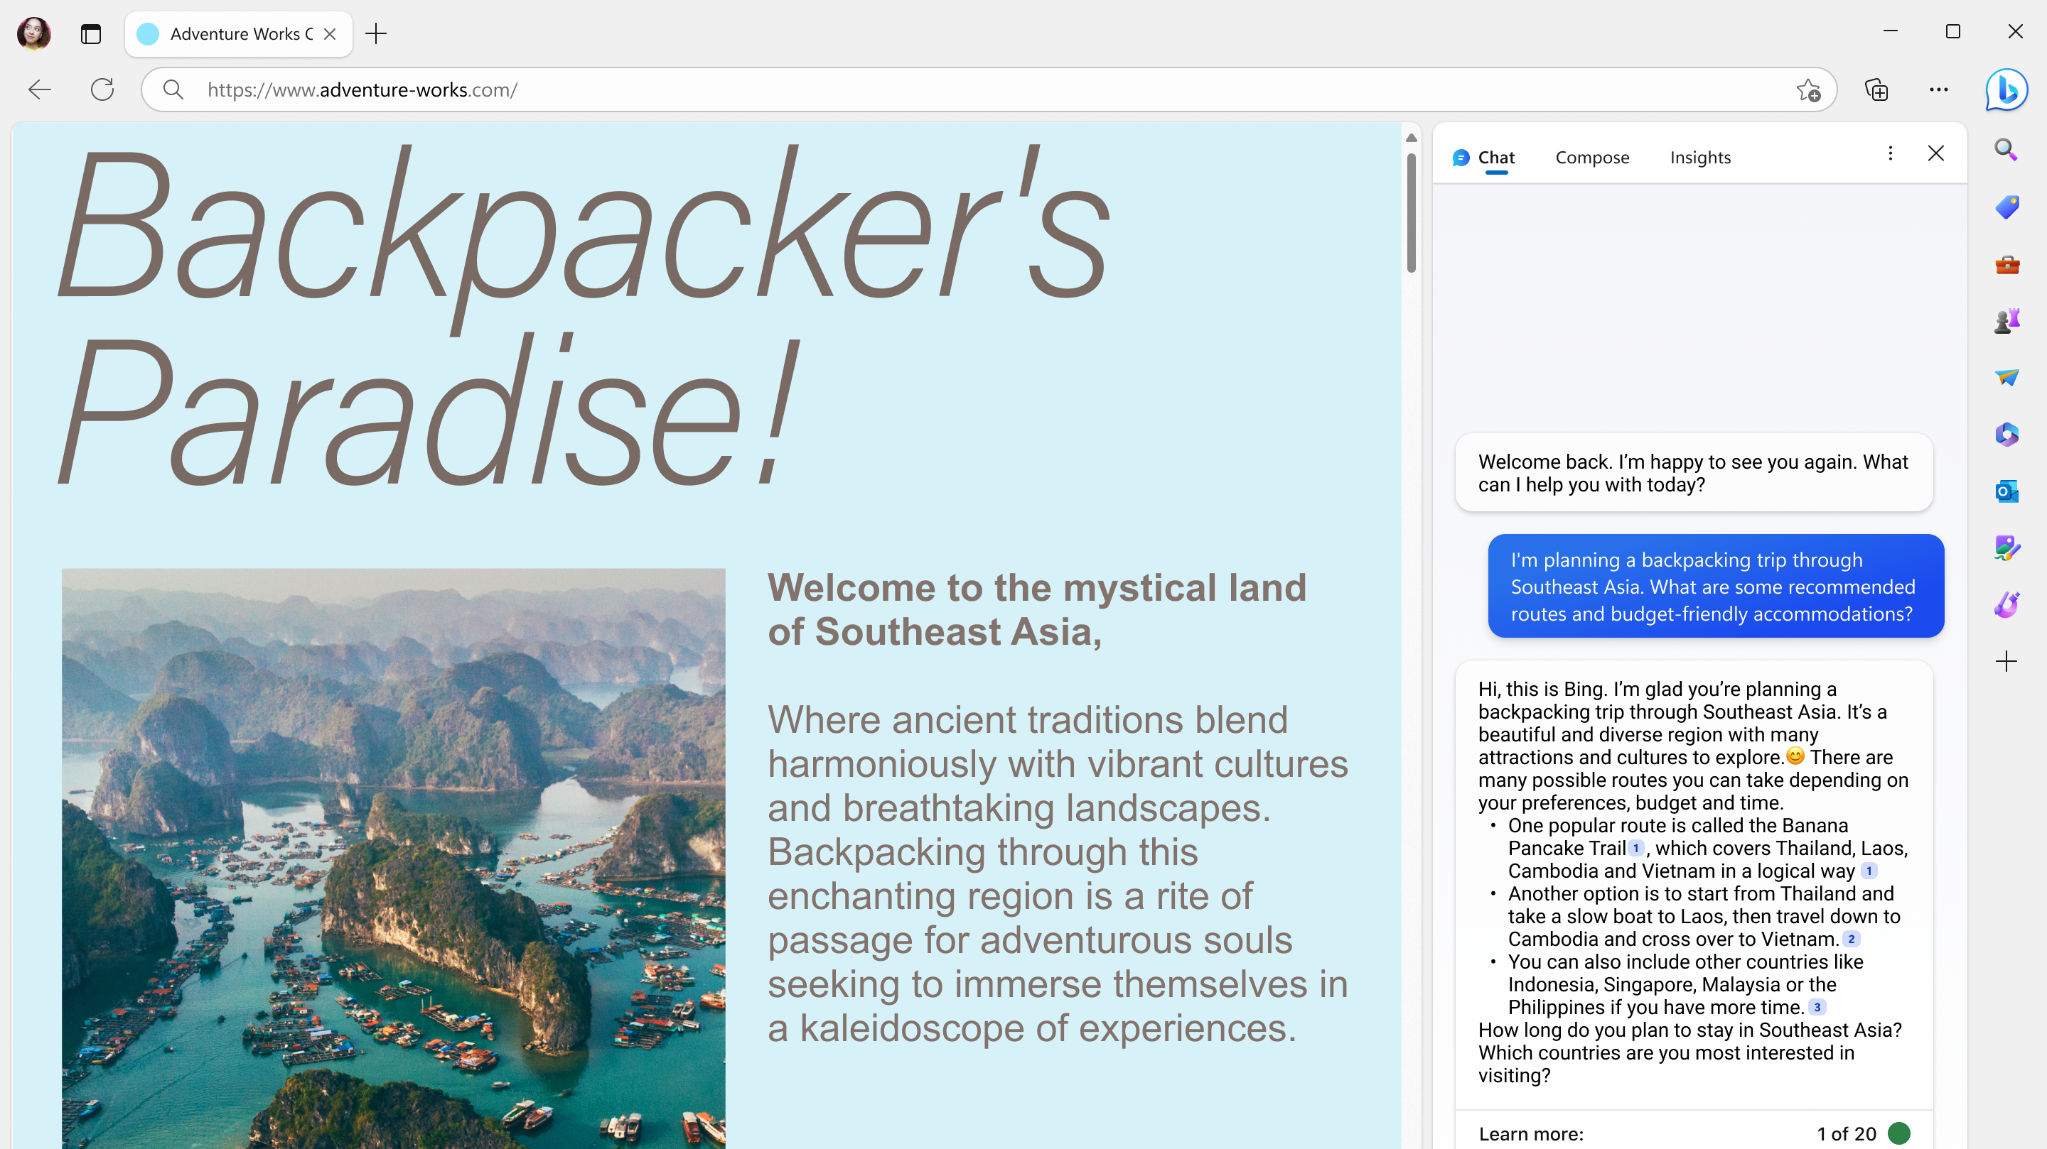
Notes:
--- Hot air ballooning is an exhilarating experience, providing a serene yet thrilling way to view the world from above. It combines adventure with the beauty of nature. Image source: Microsoft brand library

Slide 15
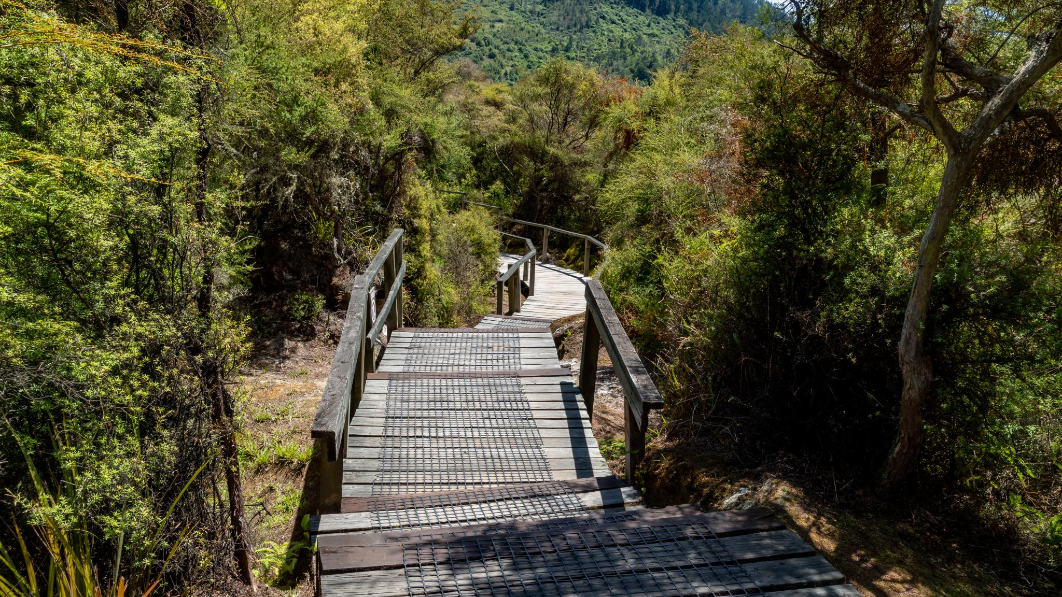
Notes:
--- Engaging in outdoor activities like hiking promotes physical health and mental well-being. Nature provides a refreshing escape that rejuvenates the spirit. Image source: Microsoft 365 content library

Slide 16
Conclusion
Celebration of Nature
We embraced the beauty of nature, highlighting its importance in our lives and adventures.
Nostalgia and Memories
Nostalgia plays a significant role in connecting us with our past experiences and cherished moments.
Culinary Delights
Exploring culinary delights allows us to indulge in diverse flavors and cultural experiences.
Adventure and Exploration
Adventure inspires us to explore new places and experiences, creating unforgettable memories.
Notes:
Today, we journeyed through a variety of topics, celebrating nature, nostalgia, culinary delights, and the thrill of adventure. Random PowerPoint Karaoke is a fun way to explore and connect with the world around us.

